Slide 1
UIT2201 – Programming and Data Structures
Linked Representation of List ADT

Slide 2
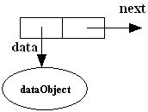
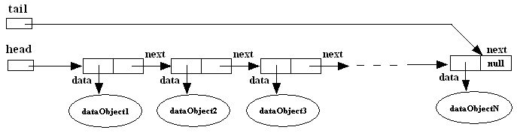
What is a Singly-linked list?
A singly linked list is a dynamic data structure consisting of a sequence of nodes, forming a linear ordering.
Each node stores:
Item (data object)
Reference (i.e., address) to the next node
Node:
Singly-linked list:
Notes:
2

Slide 3
Why linked lists?
Linked lists are used to implement many important data structures such as stacks, queues, graphs, hash tables, etc.
Linked lists are used as components of some data structures. Examples: B+ trees, skip lists, etc.
LISP An important programming language in artificial intelligence makes extensive use of linked lists in performing symbolic processing.
Memory management: An important role of operating systems. An operating system must decide how to allocate and reclaim storage for processes running on the system. A linked list can be used to keep track of portions of memory that are available for allocation.
Scrolled lists, components found in graphical user interfaces, can be implemented using linked lists.
Notes:
3

Slide 4
Singly-linked lists vs. 1D-arrays
ID-array | Singly-linked list
Fixed size: Resizing is expensive | Dynamic size
Insertions and Deletions are inefficient: Elements are usually shifted | Insertions and Deletions are efficient: No shifting
Random access i.e., efficient indexing | No random access → Not suitable for operations requiring accessing elements by index such as sorting
No memory waste if the array is full or almost full; otherwise may result in much memory waste. | Extra storage needed for references; however uses exactly as much memory as it needs
Sequential access is faster because of greater locality of references [Reason: Elements in contiguous memory locations] | Sequential access is slow because of low locality of references [Reason: Elements not in contiguous memory locations]
Notes:
4

Slide 5
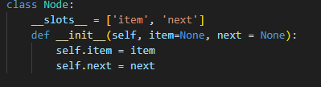
Node Representation

Slide 6
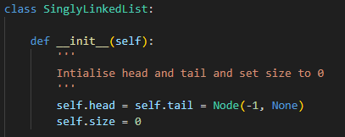
Representation
We are using a representation in which a linked list has both head and tail references:

Slide 7
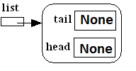
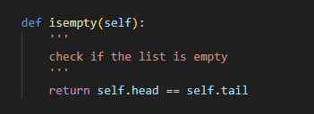
Isempty

Slide 8
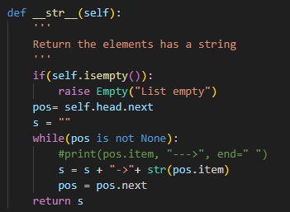
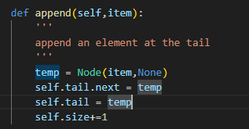
Append and display

Slide 9
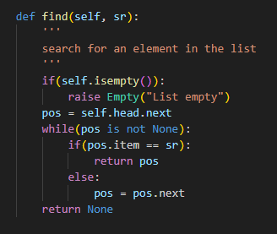
Find

Slide 10
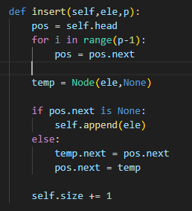
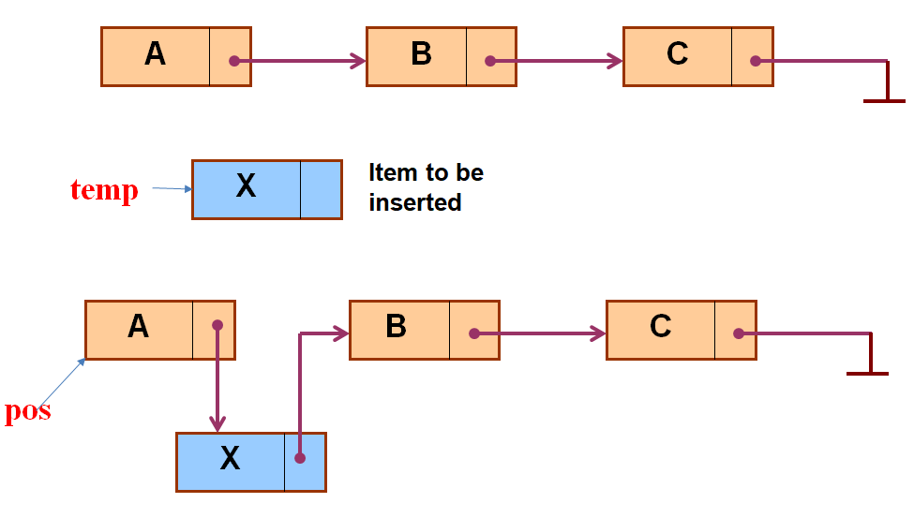
Insert by Position

Slide 11
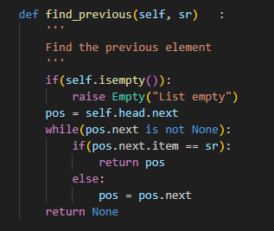
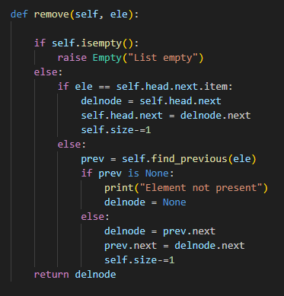
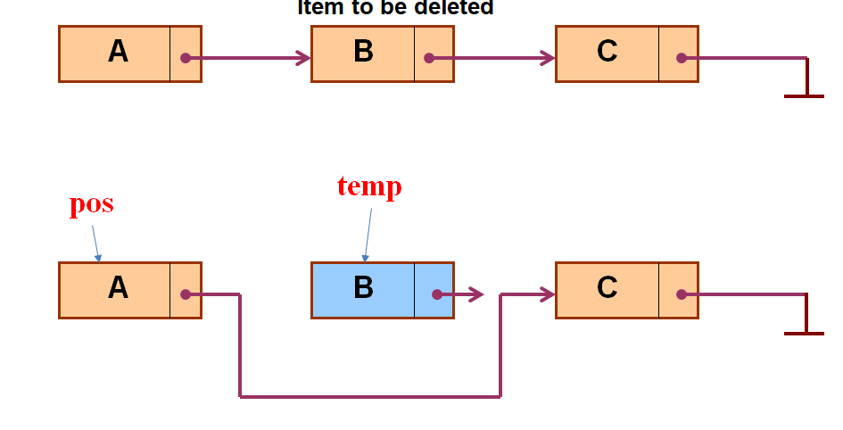
Remove element

Slide 12
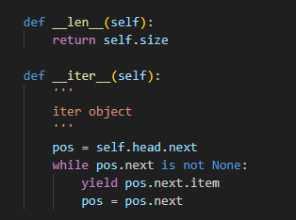
Iterator object

Slide 13
Doubly Linked List

Slide 14
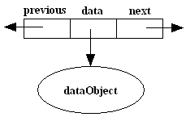
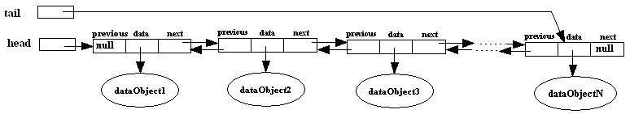
What is a Doubly-linked list?
A doubly linked list is a dynamic data structure consisting of a sequence of nodes, forming a linear ordering.
Each node stores:
Element (data object)
Reference (i.e., address) to the next node
Reference (i.e., address) to the previous node
Node:
Doubly-linked list:
Notes:
14

Slide 15
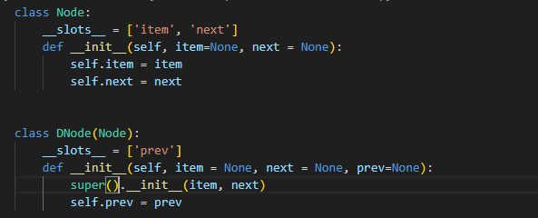
Node representation

Slide 16
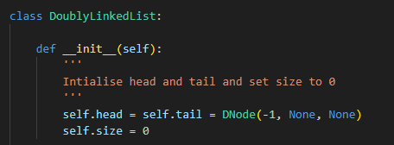
Doubly Linked List representation

Slide 17
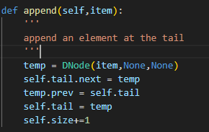
Append on Doubly Linked List

Slide 18
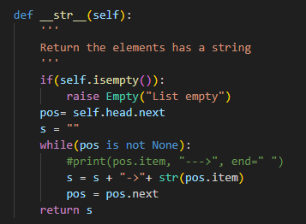
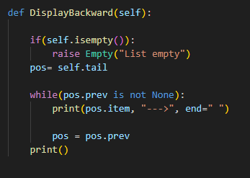
Display in Forward and Backward direction

Slide 19
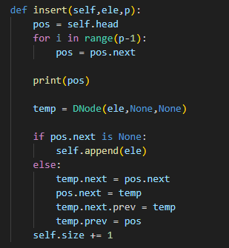
Insert by Position

Slide 20
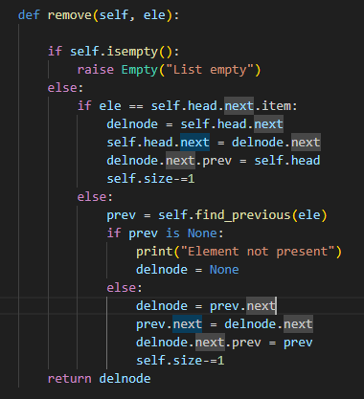
Remove element

